Slide 1
Application Program Interfaces (APIs)
CALIBRE Analytics Team (CAT)
10/17/2018

Slide 2
Agenda
Introduction
Broad definition of an API
HTTP requests
API types
Release policies
Drill down into open APIs
Open APIs in the wild
Pitfalls & Alternatives
How to access an open API (by example)
Conclusion

Slide 3
Intro
APIs are everywhere. To name a few examples, APIs are what enable us to:
Access almost all of the information we consume
Checking the weather on your phone
Allow an application to be written using multiple languages
JavaScript front end, Python back end
Enable open source integration
Python & Qlik

Slide 4
What is an API?
An API is a software intermediary that enables two applications to talk to each other.

Slide 5
What is an API?
An API is a software intermediary that enables two applications to talk to each other.
How do they talk to each other?
Through a set of clearly defined methods of communication. An API can take many forms, but often includes specifications for routines, data structures, object classes, variables or remote procedure calls.
What do they talk about?
Request/Response via HTTP request methods:
Get: Generally used to consume data
Post: Generally used to write data
Others (PUT, HEAD, DELETE, PATCH, OPTIONS)

Slide 6
GET vs POST
 | GET | POST
Cached | Can be cached | Not cached
Restrictions on data length | Yes, when sending data, the GET method adds the data to the URL; and the length of a URL is limited to 2048 characters | No restrictions
Visibility | Data is visible to everyone in the URL | Data is not displayed in the URL
Restrictions on data type | Only ASCII characters allowed | No restrictions. Binary data is also allowed
Security | GET is less secure compared to POST because data sent is part of the URL | POST is a little safer than GET because the parameters are not typically stored in browser history or in web server logs and post body is encrypted
BACK button/Reload | Harmless | Data will be re-submitted (the browser should alert the user that the data are about to be re-submitted)

Slide 7
How are APIs developed?
However you like! But like many other situations in programming, it’s best to follow a standard. Two accepted standards are REST and SOAP
 | Pros | Cons
REST (Representational State Transfer) | Follows philosophy of the open web Easier to learn Efficient & Fast Data can be stored by client to prevent multiple calls Closer to other web technologies Make up ~70% of all public APIs | Only works on top of HTTP protocol Difficult to enforce security and authorization
SOAP (Simple Object Access Protocol) | Follows a formal enterprise approach Language/platform/transport independent Security and authorization part of protocol | A lot of bandwidth spent communicating metadata Difficult to implement Only uses XML Unpopular among web and mobile developers

Slide 8
Release Policies
APIs are one of the more common ways technology companies integrate with each other.
Private: The API is for internal company use only.
Partner: Only specific business partners can use the API. For example, Facebook allowing third-party integration.
Public (Open): The API is available for use by the public. (Going to discuss in more detail)
Has potential for monetization

Slide 9
Drill Down: Open APIs
Most of the data we use at work we get from a SQL database, excel file or some form that is “handed to us”
But what if we need to leverage publically available data?
Google isn’t going to send us an Excel file!
We’ll need to use one of their open APIs

Slide 10
Open APIs in the Wild
Nearly all of the big tech companies allow access to their data via API
Other interesting available APIs:
QuickBooks
Several news sites
ESPN
Spotify
USASpending
https://www.programmableweb.com/category/all/apis

Slide 11
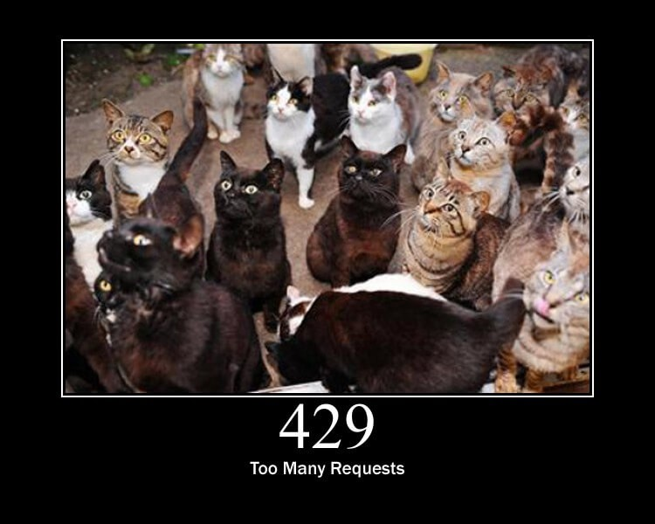
Pitfalls & Alternatives
Pitfall | Alternatives
Not always going to be an open API available for the data you need | Cry
Often limits are imposed on how many requests are allowed in a given time interval. | There are strategies to deal with being rate limited: Cache frequently used data Modify code to minimize unnecessary API calls Prioritizing active users Wait until 3AM

Slide 12
How to access an open API
Definitely going to differ by company
A good API will have good documentation
Generally involves requesting an access token first
Going to show through example with the Google Distance Matrix API

Slide 13
Conclusion
Things I hope you’ve learned:
What an API is
That there are multiple reasons for using one
The types of HTTP requests
The types of APIs
Strategies for avoiding being rate limited
General process for accessing an open API

